Slide 1
Vidyo Certified Deployment and Support Engineer Training – Day Three v3.x.x
Many of the products and features described herein remain in varying stages of development and will be offered on a when-and-if available basis. The product plans, specifications, and descriptions are provided for information only and are subject to change without notice, and are provided without warranty of any kind, express or implied. Vidyo reserves the right to modify future product plans at any time.

Slide 2

Day 3 - Agenda
Topic | Lab Exercise | Time
Adding and Configuring MultiTenant |  | 9:00 – 9:30 AM
Firewall / NAT Deployments |  | 9:30 – 10:00 AM
Break |  | 10:00 – 10:15 AM
VidyoCloud |  | 10:15 – 11:30 PM
HTTPS / SSL, LDAP / AD, CDRs, VidyoDashboard, SNMP, System Upgrades / Maintenance, Plugins |  | 11:30 AM – 12:30 PM
Lunch |  | 12:30 – 1:15 PM
Troubleshooting |  | 1:15 – 2:30 PM
Break |  | 2:30 – 2:45 PM
Review and Exam |  | 2:45 – 5:00 PM

Slide 3
Configuring MultiTenant

Slide 4
Multi-tenant - General Overview
Logically divides the VidyoPortal into multiple virtual portals
Ideal for CSPs and large enterprises
Each tenant has a unique address (URL)
Tenants can be configured to be completely isolated or they can be configured to allow for unidirectional or bidirectional communication with other tenants
Resources (e.g. installs, lines, seats, etc.) can allocated per tenant
Lines can either be shared or limited numbers can be allocated per tenant

Slide 5
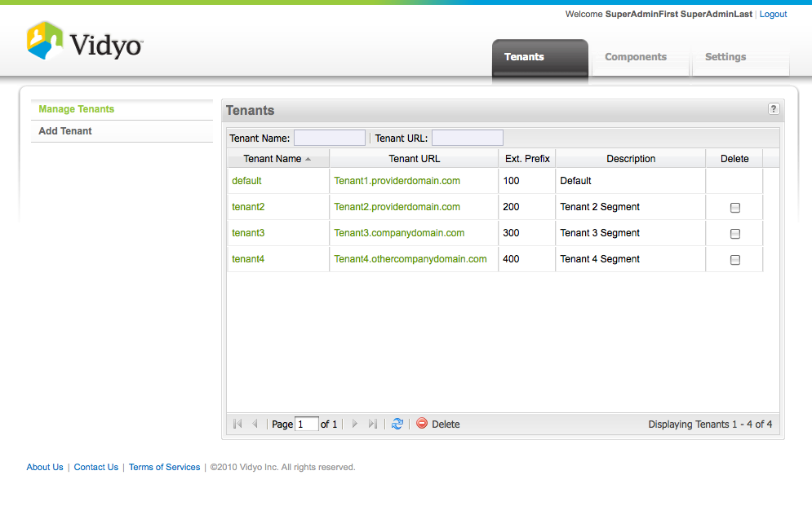
Multi-tenant – Adding Tenants
Upon having licensed the Multi-tenant feature, you can Add Tenants in the Super Admin pages, Tenants Tab:

Slide 6
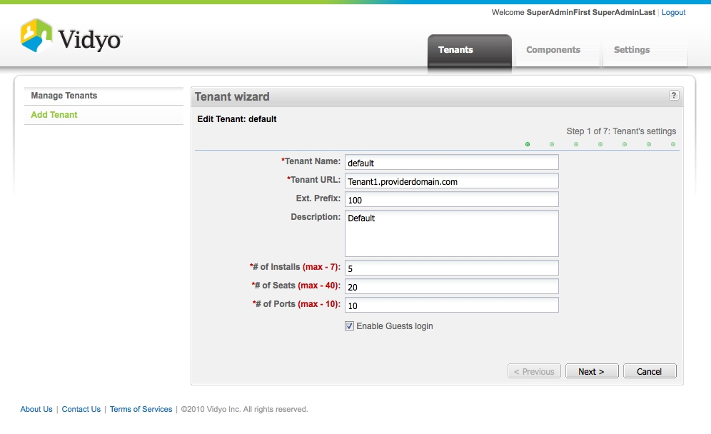
Multi-tenant – Configuration
Click on a Tenant Name to Edit, or Click Add Tenant to add a New Tenant:
Enter Tenant Name
Enter Tenant URL
Enter Tenant Prefix
Assign Licenses to Tenant
Enable or Disable Guest access accordingly.

Slide 7
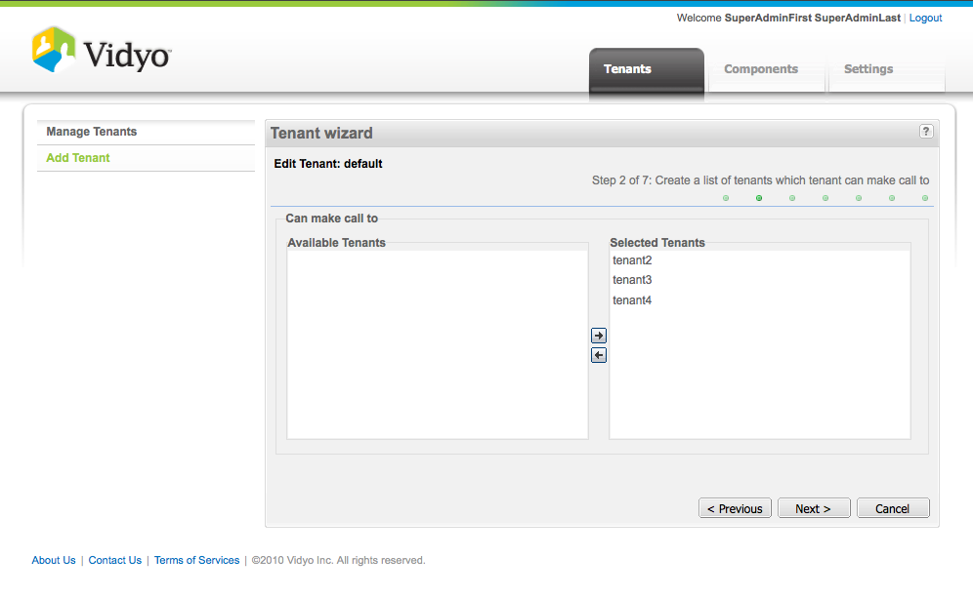
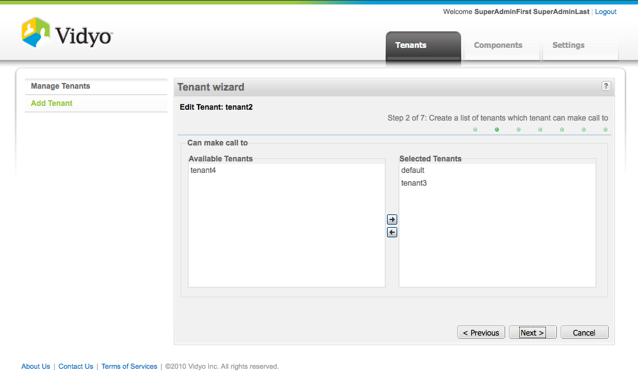
Multi-tenant – Configuration
Set up Tenant Call To: matrix according to needs and as you build each Tenant:
Assign VidyoProxies, VidyoReplays and VidyoGateways as needed to each Tenant on remaining pages.

Slide 8
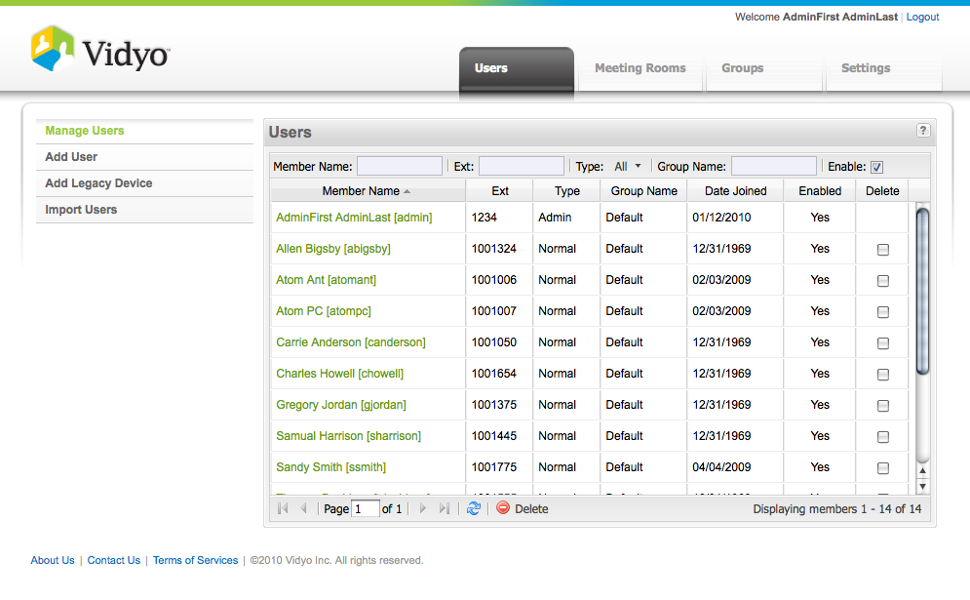
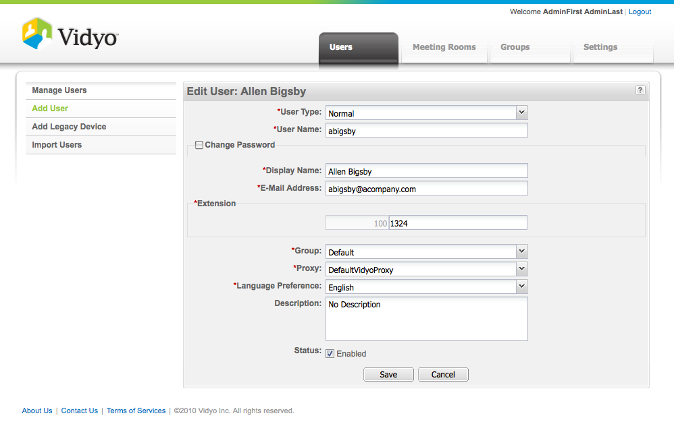
Multi-tenant – Configuration
Configure each Tenant Admin pages and Add Users to Tenants as needed:
User in Tenants will have the Tenant Prefix preceding their Extension

Slide 9

MultiTenant - Demo
During this demo, the trainer will demonstrate the following:
Add a new tenant
Make calls from one tenant to another
CHECK THIS OUT!

Slide 10
MultiTenant - Lab Exercise #17
Use the provided lab exercise document to complete the following objectives:
Add a new tenant
Make calls from one tenant to another

Slide 11
Firewall / NAT Deployments

Slide 12
Firewall / NAT – Vidyo Call Flow
VidyoPortal
Web Services
HTTP/HTTPS: 80/443
VidyoManager
RMCP(S): 17991
VidyoDesktop Endpoint
EMCP(S): 17992
VidyoRouter
SCIP(S): 17990
UDP (6 ports): 50000 - 65535

Slide 13
Firewall / NAT – VidyoPortal/Router Firewall Ports
VidyoPortal/Router specific ports REQUIRED to be open:
Bidirectional UDP/TCP 53 DNS
Inbound TCP Port 2222 Server management (internal use only)
Inbound TCP Port 80 Web access to VidyoPortal and Admin Web Interfaces
Inbound TCP Port 443 Secure web access to VidyoPortal and Admin Web Interfaces
Inbound TCP Port 17992 Client connection to VM (EMCP)
Inbound TCP Port 17990 Client connection to VidyoRouter (SCIP)
Bidrectional UDP 50,000-65,535 Media feeds from participants (6 ports per endpoint)
Inbound to Portal TCP 17991 RMCP from Routers for VidyoCloud.
Inbound TCP Port 3306 Database port (For CDR access to VidyoPortal)
Outbound TCP 25 SMTP outbound for emails (VidyoPortal and Replay)
Outbound UDP 123 NTP (all servers)
Outbound TCP 389/636 LDAP/SLDAP (VidyoPortal)
Inbound UDP Port 161 – 162 SNMP: Inbound to Server (all servers where SNMP installed)
Please reference the Vidyo Firewall and NAT documentation (click here)

Slide 14
Firewall / NAT – VidyoGateway Firewall Ports
VidyoGateway specific ports REQUIRED to be open:
Bidirectional UDP/TCP 53 DNS
Inbound TCP Port 80 Admin web access / SOAP messaging with VidyoPortal
Inbound TCP Port 443 Secure web access to VidyoPortal
Bidirectional TCP Port 1719 H.323 GK registration
Bidirectional TCP Port 1720 H.323 call setup
Bidirectional 5060 UDP SIP call signaling
Outbound 17990 Connection with VidyoRouter (SCIP)
Outbound 17992 Connection with VidyoManager (EMCP)
Bidirectional 1024-65535 TCP Dynamic H.323 call control (H245)
Bidirectional 1024-65535 UDP Dynamic media to/from legacy
Bidirectional 1024-65535 UDP Dynamic UDP media to/from VidyoRouter
Please reference the VidyoGateway NAT Traversal documentation (click here)

Slide 15
Common Deployment Options

Slide 16
Common Deployment Options – How to decide?
Driving factors behind deployment type
Level of security required by customer
Existing Network Architecture
Existing IT policies
Security Regulations (government / health)

Slide 17


Common Deployment Options - Public Deployment
LAN
WAN
Firewall/NAT
Optional Firewall
EMCP(S): 17992
Office User
SCIP(S): 17990
UDP (6 ports): 50000 - 65535
EMCP(S): 17992
SCIP(S): 17990
UDP (6 ports): 50000 - 65535
64.25.26.27
EMCP(S): 17992
VidyoOne
Home User
SCIP(S): 17990
UDP (6 ports): 50000 - 65535
EMCP(S): 17992
Guest User
64.25.26.28
SCIP(S): 17990
VidyoGateway
UDP (6 ports): 50000 - 65535
A customer with a VidyoOne and a VidyoGateway
The customer does not have an internal DNS sever and have decided to go with a Public Deployment. (Public may still have a firewall)

Slide 18
Common Deployment Options - NAT’ed Deployment
LAN
WAN
LAN
Firewall/NAT
Firewall/NAT
EMCP(S): 17992
64.25.26.27
Office User
SCIP(S): 17990
UDP (6 ports): 50000 - 65535
EMCP(S): 17992
SCIP(S): 17990
UDP (6 ports): 50000 - 65535
10.25.26.27
EMCP(S): 17992
VidyoPortal
Home User
SCIP(S): 17990
UDP (6 ports): 50000 - 65535
64.25.26.28
EMCP(S): 17992
Guest User
10.25.26.28
SCIP(S): 17990
VidyoRouter
UDP (6 ports): 50000 - 65535
A customer with a VidyoPortal and a standalone VidyoRouter
The customer has decided to place the infrastructure in their LAN/Datacenter behind a NAT firewall with a 1 to 1 NAT.

Slide 19
Common Deployment Options - DMZ Deployment
LAN
WAN
DMZ
LAN
64.25.26.27
Office User
EMCP(S): 17992
SCIP(S): 17990
UDP (6 Ports): 50,000 – 65,535
10.25.26.27
64.25.26.29
VidyoPortal
EMCP(S): 17992
SCIP(S): 17990
UDP (6 Ports): 50,000 – 65,535
10.22.26.29
Home User
VidyoRouter
64.25.26.28
EMCP(S): 17992
SCIP(S): 17990
UDP (6 Ports): 50,000 – 65,535
Guest User
10.22.26.28
VidyoReplay
Firewall/NAT
Firewall/NAT
Firewall/NAT
A customer with a VidyoRouter, VidyoPortal and a VidyoReplay.
The customer wants a higher security deployment and doesn’t want UDP traffic to enter their LAN.

Slide 20
Configuring a NAT for a VidyoPortal/Router

Slide 21
NAT – VidyoPortal/Router Configuration
Must have private DNS and public DNS configured
Internal IP address = 192.168.0.100 – hostname vidyo.company.com
External IP address = 66.77.88.99 – hostname vidyo.company.com
Users must browse to portal via hostname
Doman in portal should be just domain name
domain = company.com
Set Portal hostname
Example – hostname = vidyo*
* Setting the portal hostname can only be done via the shell menu
This is shown on the next slide

Slide 22
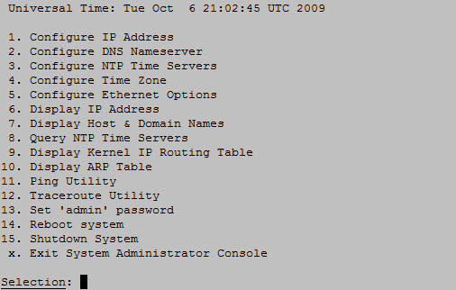
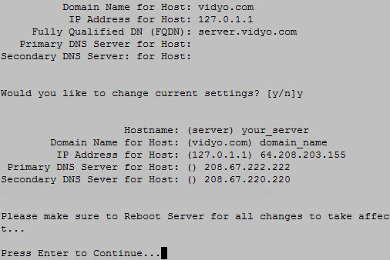
NAT - VidyoPortal/Router Configuration
SSH to the portal over port 2222
Username: admin
Password: password / P@ss001

Slide 23
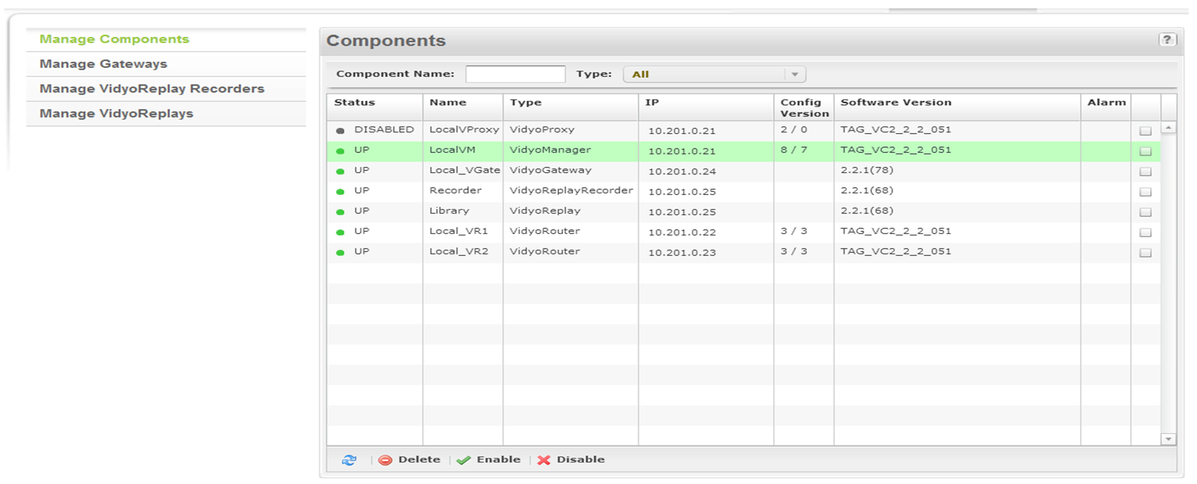
NAT - VidyoPortal Configuration
Confirm the VidyoManager to has the FQDN correct.
Login to the portal Super Admin pages, go to Components TAB / Manage Components:

Slide 24
NAT – VidyoRouter Configuration
Navigate to the Super Admin page, go to Components TAB / Manage Components:
Next, you will need to configure each VidyoRouter to be addressed by it’s FQDN.
Double click the routers name to configure.

Slide 25
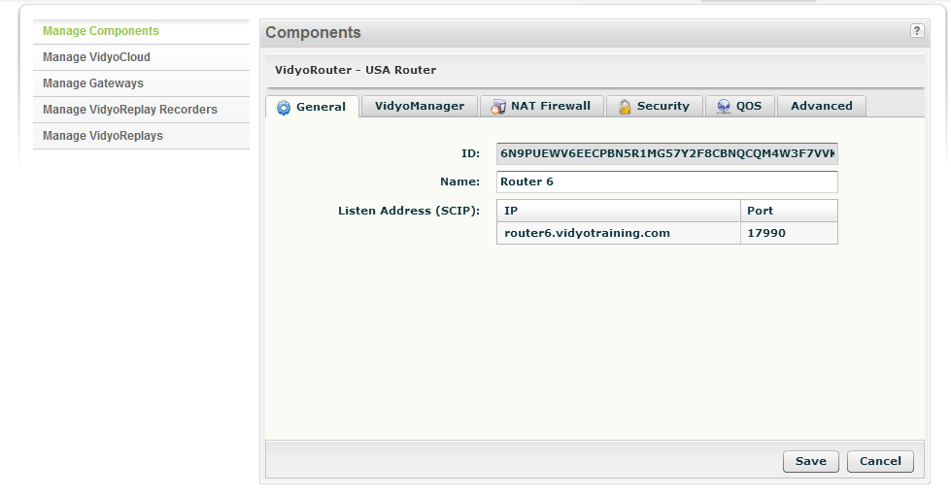
NAT – VidyoRouter Configuration
Under Listen Address (SCIP), edit SCIP address (VidyoRouter signaling address) by clicking the text in the IP column, and enter the server FQDN here
routerhostname.domain

Slide 26
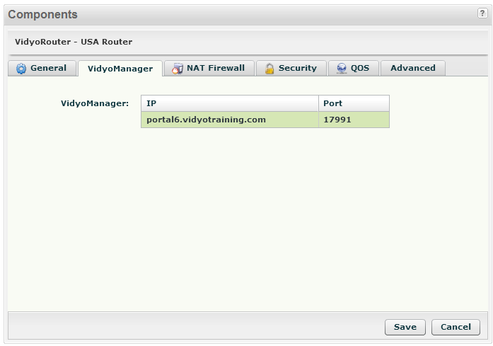
NAT – VidyoRouter Configuration
Under VidyoManager, edit VidyoManager IP address by clicking the text in the IP column, and enter the server FQDN here
portalhostname.domain

Slide 27
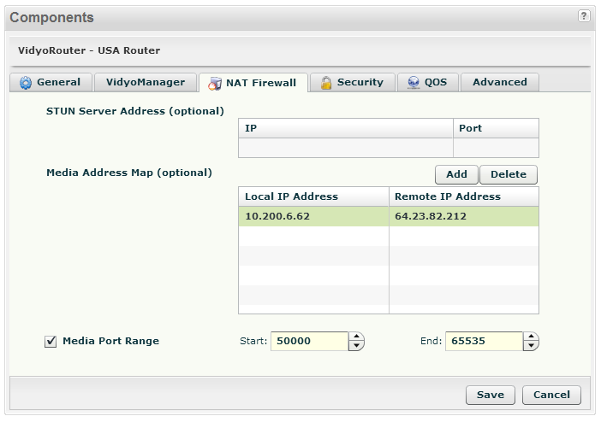
NAT – VidyoRouter Configuration
In the VidyoRouter Component pages, go to NAT Firewall TAB:
You will need to configure the VidyoRouter Media Mapping from private to public addresses.

Slide 28
NAT – VidyoRouter Configuration
Under Media Address Map, click Add button and enter each NAT translation required.
For each NAT map, enter the Local IP Address (private) and Remote IP Address (public); the inside/outside NAT addresses needed.
If there is a NAT from the private LAN towards the DMZ, you will need a media map rule for that.
In deployments where there is a dual NAT, one NAT from the Public Network to the server, and one from the private LAN to the server, there will be two Media Map statements.

Slide 29
Trainer Demo
During this demo, the trainer will demonstrate the following:
Demonstrate VidyoPortal/Router NAT settings
CHECK THIS OUT!

Slide 30
Setting Up VidyoCloud

Slide 31
VidyoCloud - Objectives
Describe the VidyoCloud feature
Describe Inter-pool Preferences
Demonstrate common VidyoCloud deployments (Basic NAT, DMZ)
Describe VidyoCloud Best Practices
Set Up VidyoCloud (Trainer Demo/Exercise)

Slide 32
VidyoCloud - Benefits
More efficient network bandwidth utilization
Improved latency for conferences by localizing traffic
Supporting large conferences spanning over multiple VidyoRouters
Shared capacity with floating VidyoLine licenses among regions
Simplified Firewall configurations

Slide 33




VidyoCloud - What is a Pool?
A Pool is one or multiple routers associated with a geographical location
A VidyoRouter can only be in one Pool
A location may have several Pools.
Asia
VidyoRouter
USA
VidyoPortal
Europe
VidyoRouter
VidyoRouter

Slide 34

VidyoCloud - Efficient Bandwidth Utilization
LAN
WAN
LAN
Europe Office
1Mb
9Mb
USA Office Pool
3Mb
1Mb
3Mb
1Mb
VidyoRouter
3Mb
Standalone VidyoRouter
3Mb
1Mb
USA Office Pool
Europe Office Pool
3Mb
3Mb
1Mb
1Mb
VidyoRouter
w/Additional Standalone VidyoRouter and VidyoCloud
3Mb
VidyoRouter

Slide 35
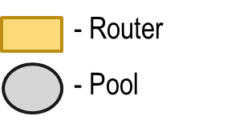
VidyoCloud - Inter-Pool Preferences
VidyoRouters within a single Pool will use Full Mesh topology
VidyoRouter Pools will be assigned a priority which will decide which two locations will connect in case of more than one choice.
1
1
1
3
2
2
3
2
4
1
3
2

Slide 36
VidyoCloud - Inter-Pool Preference Static Path
Data Center
High
High
VidyoRouter
Secure Office A
Secure Office B
NONE
VidyoRouter
VidyoRouter
In the example above, media from each office will be routed through the Data Center pool.
No firewall rules need to added to allow communications between the two offices

Slide 37
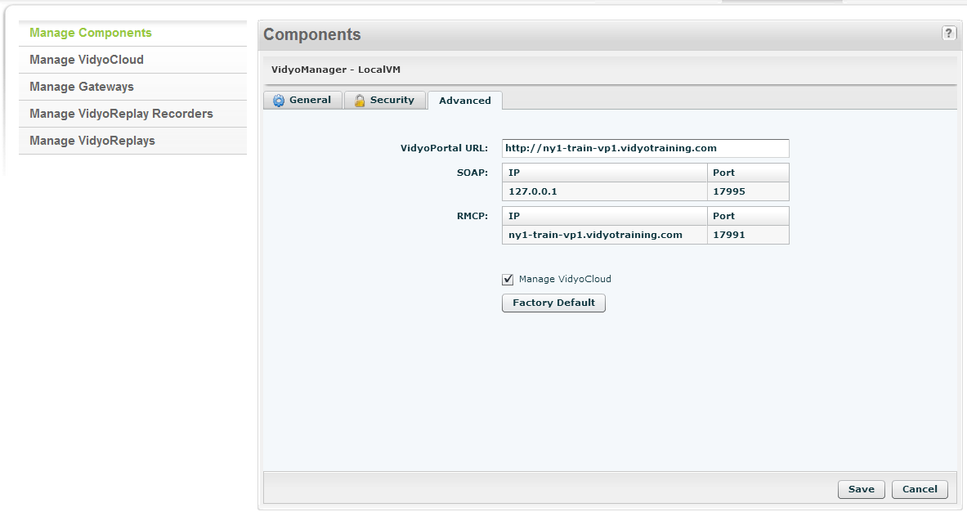
VidyoCloud – Initial Configuration
Navigate to Super Admin – Components Page
Double Click on LocalVM
Click the Advanced Tab
Enable Manage VidyoCloud Option
Define VidyoRouter Pools
Add Location Tags (if applicable)
Define Endpoint Rules
Define Inter-Pool Preferences

Slide 38
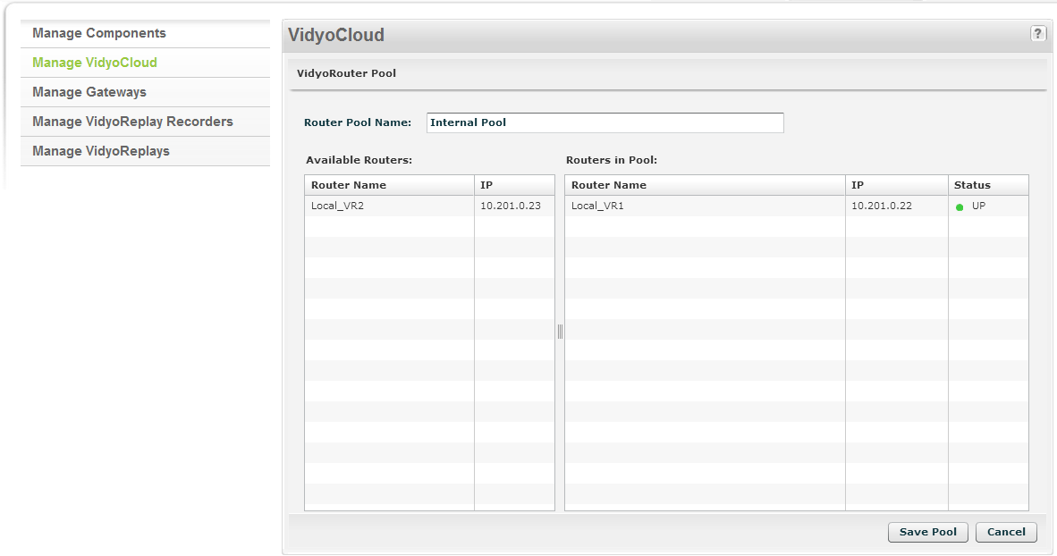
VidyoCloud – Define VidyoRouter Pools

Slide 39
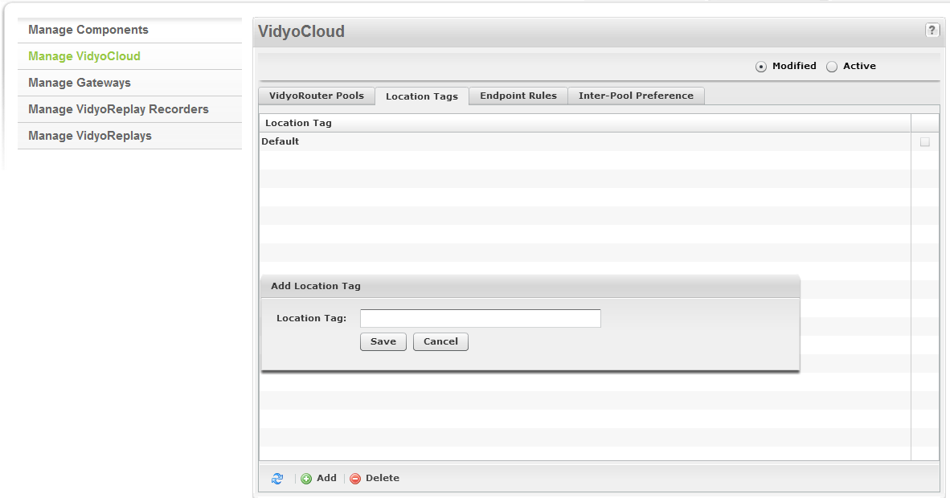
VidyoCloud - Adding Location Tags

Slide 40
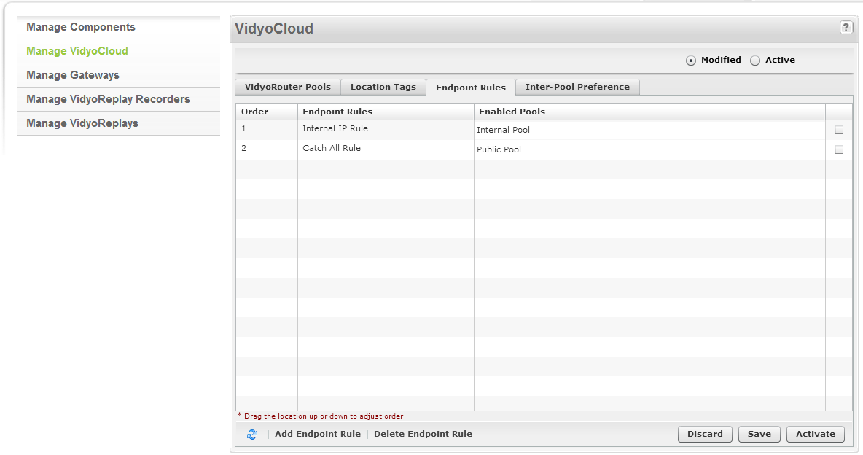
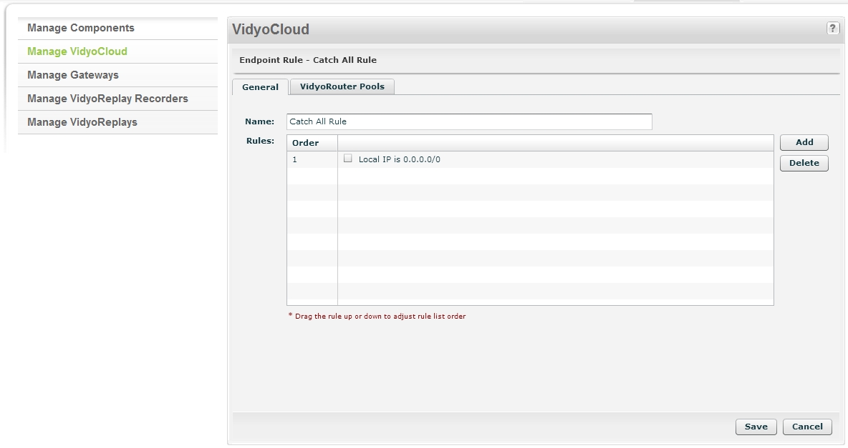
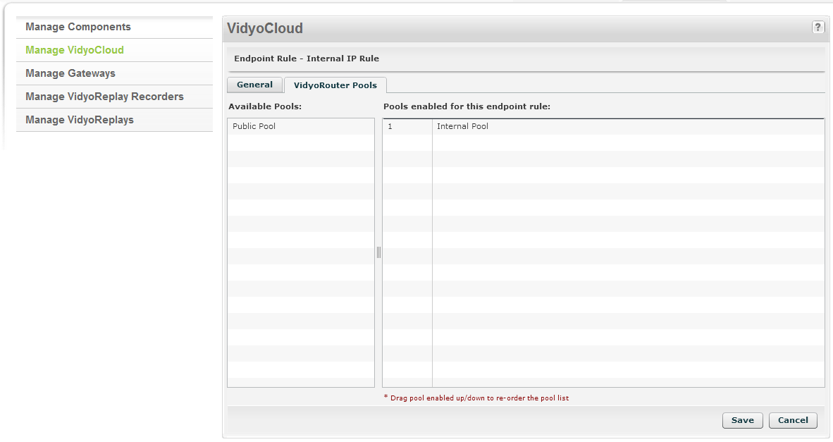
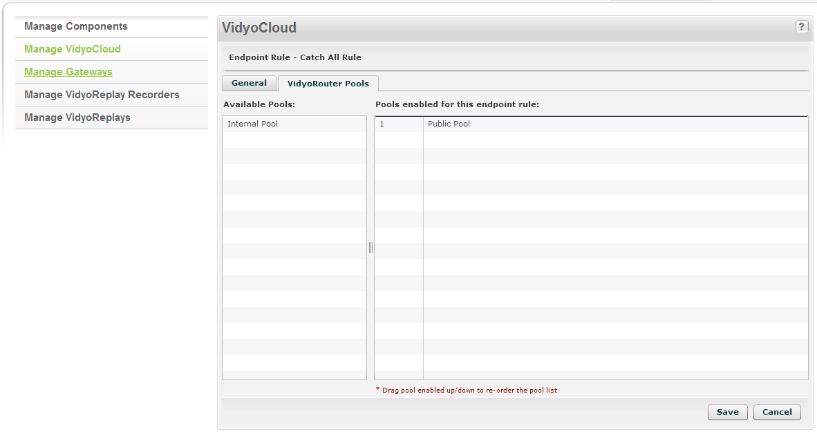
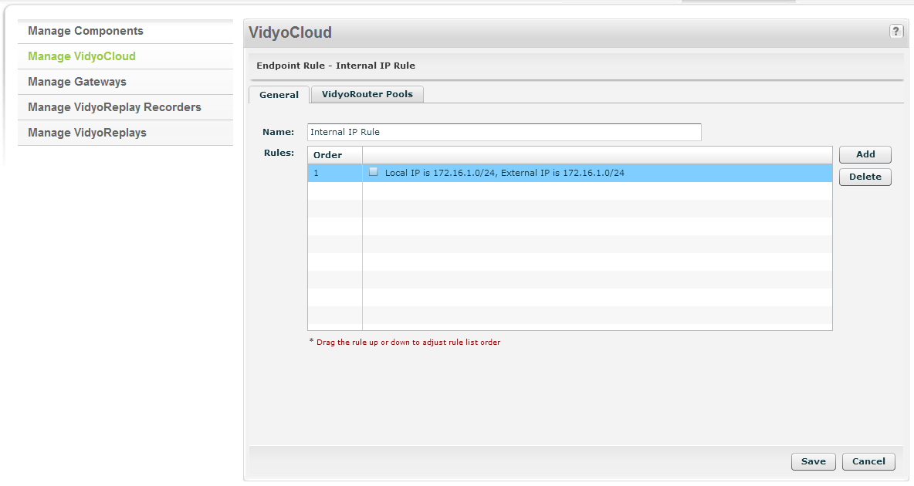
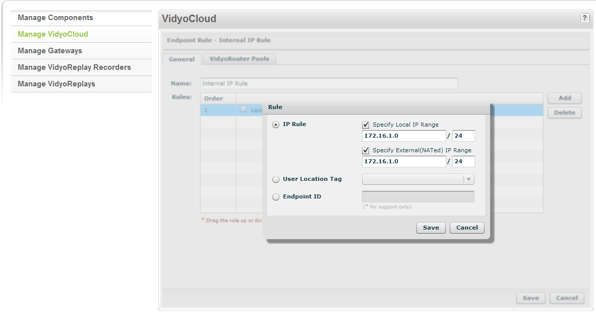
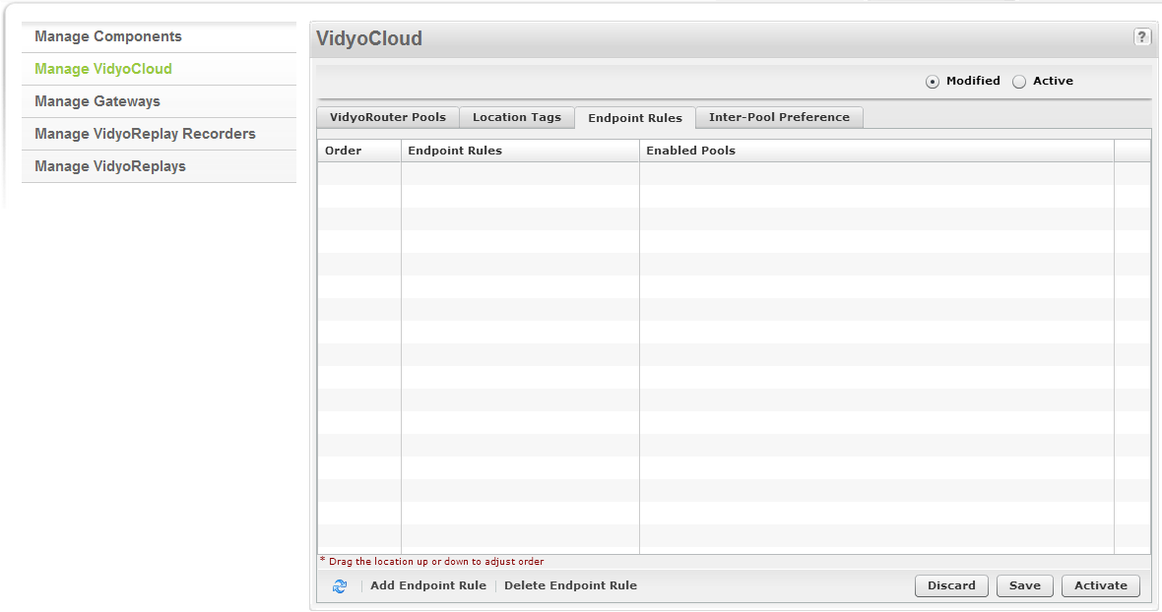
VidyoCloud - Adding Endpoint Rules

Slide 41
VidyoCloud - Location Tag Rule Example
WAN
64.12.15.46
VidyoManager
USA Pool
Europe Pool
64.12.15.48
64.12.15.49
VidyoRouter
VidyoRouter
USA Employee
*USA Location Tag Assigned
Europe Employee
*Europe Location Tag Assigned
USA employee will be captured by a USA Location Tag rule and routed to the USA Pool
Europe employee will be captured by a Europe Location Tag rule and routed to the Europe Pool

Slide 42
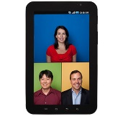
VidyoCloud - NAT IP Rules
LAN
WAN
VidyoMobile Guest
Local IP – 10.10.10.184
External/NAT’d IP – 160.79.220.2
64.12.15.46
10.10.10.6
VidyoManager
Internal Pool
64.12.15.47
Public Pool
10.10.10.7
VidyoRouter
Employee
Local IP - 10.10.10.105
External/NAT’d IP – 10.10.10.105
Firewall/NAT
64.12.15.48
VidyoRouter
Employee will be captured by a single IP rule with the local IP AND external/NAT IP range set to 10.10.10.0/24 and routed to the Internal Pool
VidyoMobile guest will be captured by a Catch All rule (0.0.0.0/0) and routed to the Public Pool

Slide 43
VidyoCloud - NAT with DMZ IP Rule
LAN
DMZ
WAN
Employee A
Local IP: 10.10.10.105
External/NAT’d IP: 172.16.3.1
64.12.15.46
172.16.3.1
Guest
Local IP – 172.16.1.133
External/NAT’d IP - 64.12.34.53
172.16.3.6
VidyoManager
Internal Pool
Employee B
Local IP: 10.10.10.106
External/NAT’d IP: 172.16.3.1
Public Pool
64.12.15.47
Firewall/NAT
172.16.3.7
Firewall/NAT
VidyoRouter
64.12.15.48
VidyoRouter
LAN users will be captured by a 172.16.3.1/32 external NAT IP rule and routed to the Internal Pool
Guests will be captured by a Catch All rule (0.0.0.0/0) and routed to the Public Pool

Slide 44
VidyoCloud - Best Practices
Remember to activate VidyoCloud when you want your changes to take effect.
Place internal IP rules above location tag rules.
Place the Catch All IP rule at the bottom of your rules.
The available VidyoRouter list (based on VidyoCloud rules) are assigned to users during the sign-in process. Keep this in mind when testing your VidyoCloud rules (you may need to sign out and sign back in)
VidyoProxy connections will report the External/NAT’d IP of the VidyoRouter that they are proxying through. For this reason, please keep this in mind when creating your endpoint rules.
Internal IP rules should include both the Local IP and External NAT’d IP address range. In many cases, it’s the same but it may not be if the customer is using internal NATs between the users and the VidyoPortal.
External/NAT’d IP address of a VidyoMobile endpoint will not be a private IP (e.g. 10.x.x.x) so by matching up the local and External/NAT’d IP for your internal endpoints, it will prevent VidyoMobile end points from being captured by internal IP rules.

Slide 45
Trainer Demo
During this demo, the trainer will demonstrate the following:
Seting up a VidyoCloud
Route users to VidyoRouter pools with their location tags
CHECK THIS OUT!

Slide 46
VidyoCloud - Lab Exercise #18
Use the provided lab exercise document to complete the
following objectives:
Set up VidyoCloud
User location tag rules to route your admin account to the appropriate VidyoRouter pool

Slide 47
Advanced Topics – Available on training.vidyo.com

Slide 48
Advanced Topics – General Overview
HTTPS and SSL
VidyoPortal Hot Standby
Inter Portal Communication (IPC)
LDAP/AD Authentication
CDRs
SNMP
Plugins

Slide 49
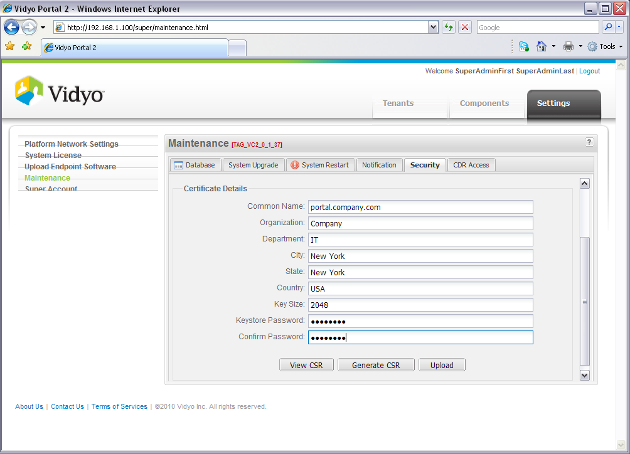
HTTPS and SSL – Configuration
Go to Super Admin / Settings / Maintenance / Security TAB
Enter all Information for CSR generation
Spell out states (no abbreviations)
Set Key Size according to your government limits (2048 recommended in USA)
Wildcard certificates are supported and recommended for multi-tenant

Slide 50
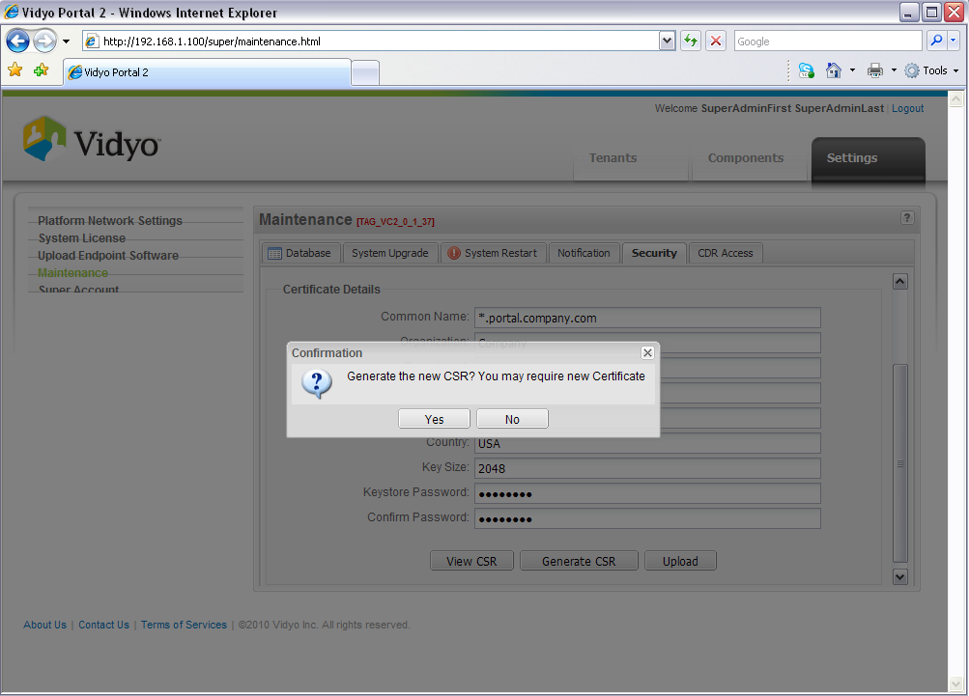
HTTPS and SSL – CSR Generation
Upon completing form, Press Generate CSR
CSR will be created on Portal

Slide 51
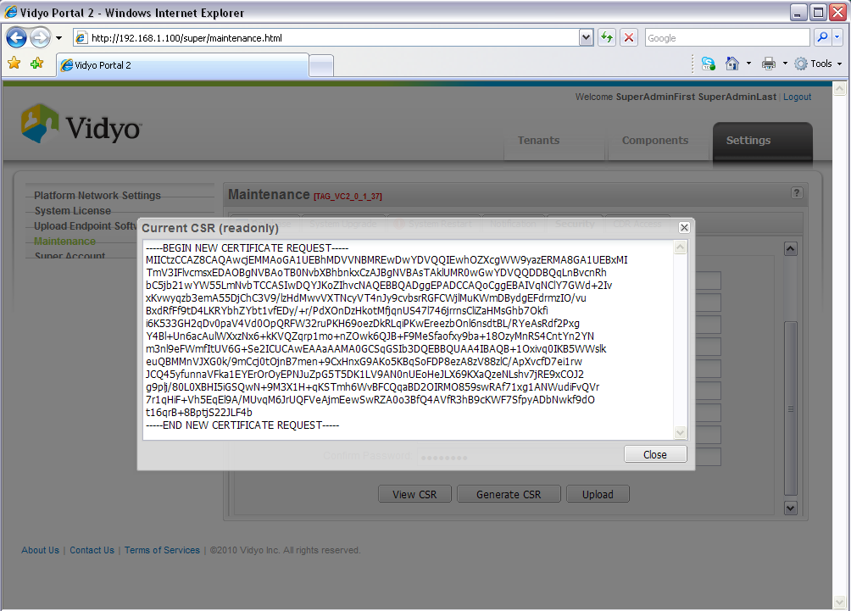
HTTPS and SSL – CSR Submission
Upon CSR generation, Press View CSR to copy CSR for CA (Certificate Authority)
Be sure to Copy all the info in the window, including the headers.

Slide 52
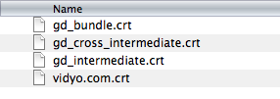
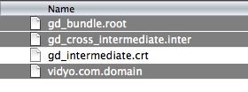
HTTPS and SSL - Certificates
Upon submitting the CSR data to your CA, they will then provide you 2-4 Cert files.
Rename the Root file extension (if received) from .crt to .root
Rename the Intermediate file extension from .crt to .inter
Rename the Domain file extension from .crt to .domain

Slide 53
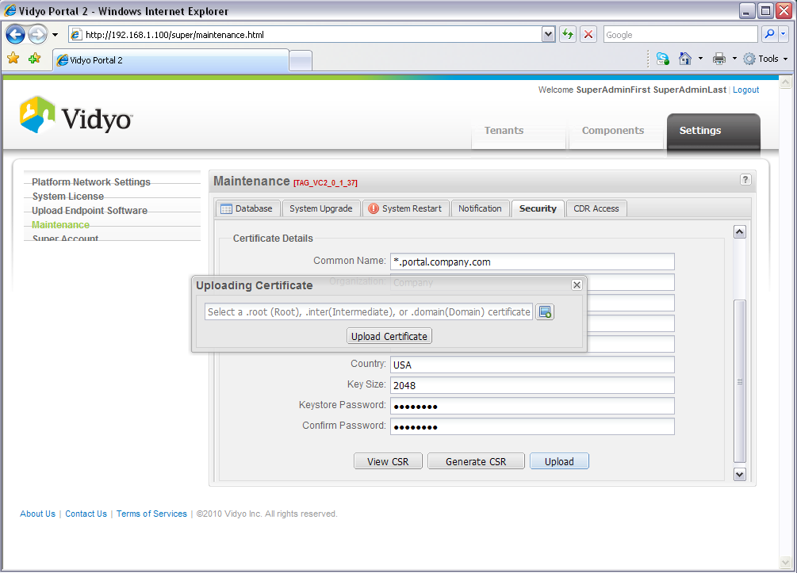
HTTPS and SSL – Uploading to Portal
Upload the files to the Portal in the following order:
1. Root
2. Inter
3. Domain

Slide 54
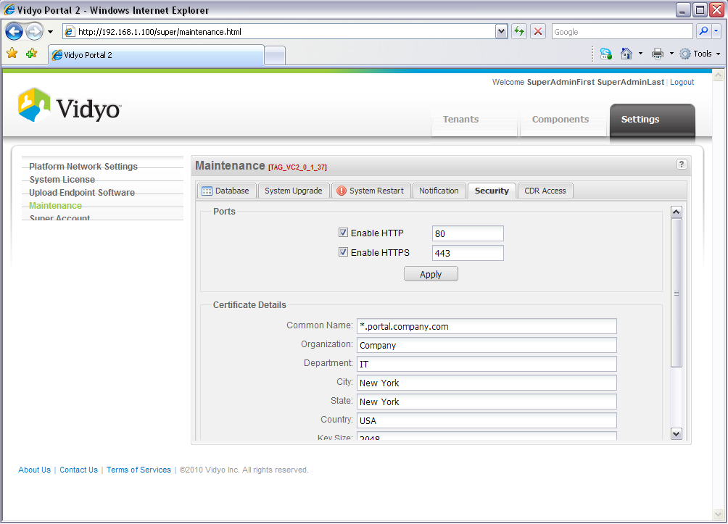

HTTPS and SSL – Enabling HTTPS on Portal
Enable HTTPS on Portal (and also Disable HTTP if you want HTTPS only access). Press Apply. System Reboot may be required.
If enabling HTTPS only, Portal will redirect HTTP to HTTPS.

Slide 55

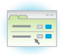
VidyoPortal Hot Standby – General Overview
Components:
Two VidyoPortals
Hot Standby Licenses
Requires three IP address for public deployments with one being the cluster (shared) IP address. Four IP addresses are required in a NAT’d deployment.
Features:
Automatic and manual failover options
License and configuration mirroring
Automatic database synchronization
In-Service Upgrade/Maintenance
IP Network
IP Router
Cluster IP
Active
VidyoPortal
Hot Standby VidyoPortal

Slide 56
VidyoPortal Hot Standby – Switchover
Conditions for Switchover:
IP network failure of 20 or more seconds
Restart of the Active VidyoPortal
Shutdown of the Active VidyoPortal
VidyoManager failure
Web services failure (Note that restarting web services from the Super Admin portal will not cause the Active VidyoPortal to switch over to the Standby VidyoPortal.)
Switchover Timing
Within 20 seconds of when the Active VidyoPortal becomes unreachable, the Standby will take over and start all the services.
The entire process typically takes between 40 to 60 seconds.

Slide 57
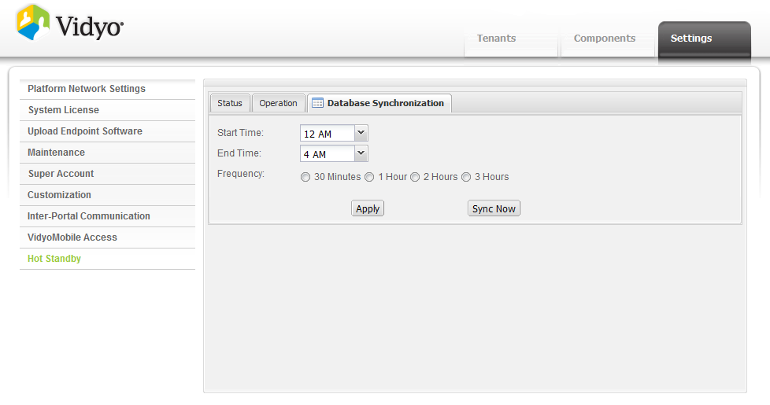
VidyoPortal Hot Standby – Database Synchronization
By scheduling the database synchronization, you are selecting the window of time during which the synchronization will occur and how often it will occur during that window. (Slight delay to users searching may occur during synchronization)
The default is 12 to 4 AM, once per hour.

Slide 58
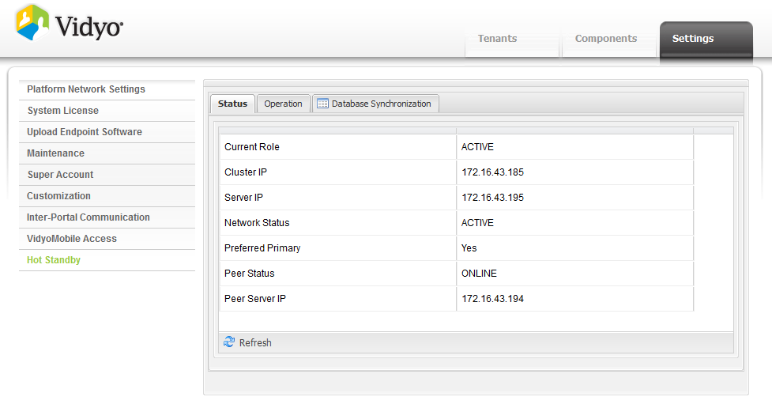
VidyoPortal Hot Standby – Status

Slide 59
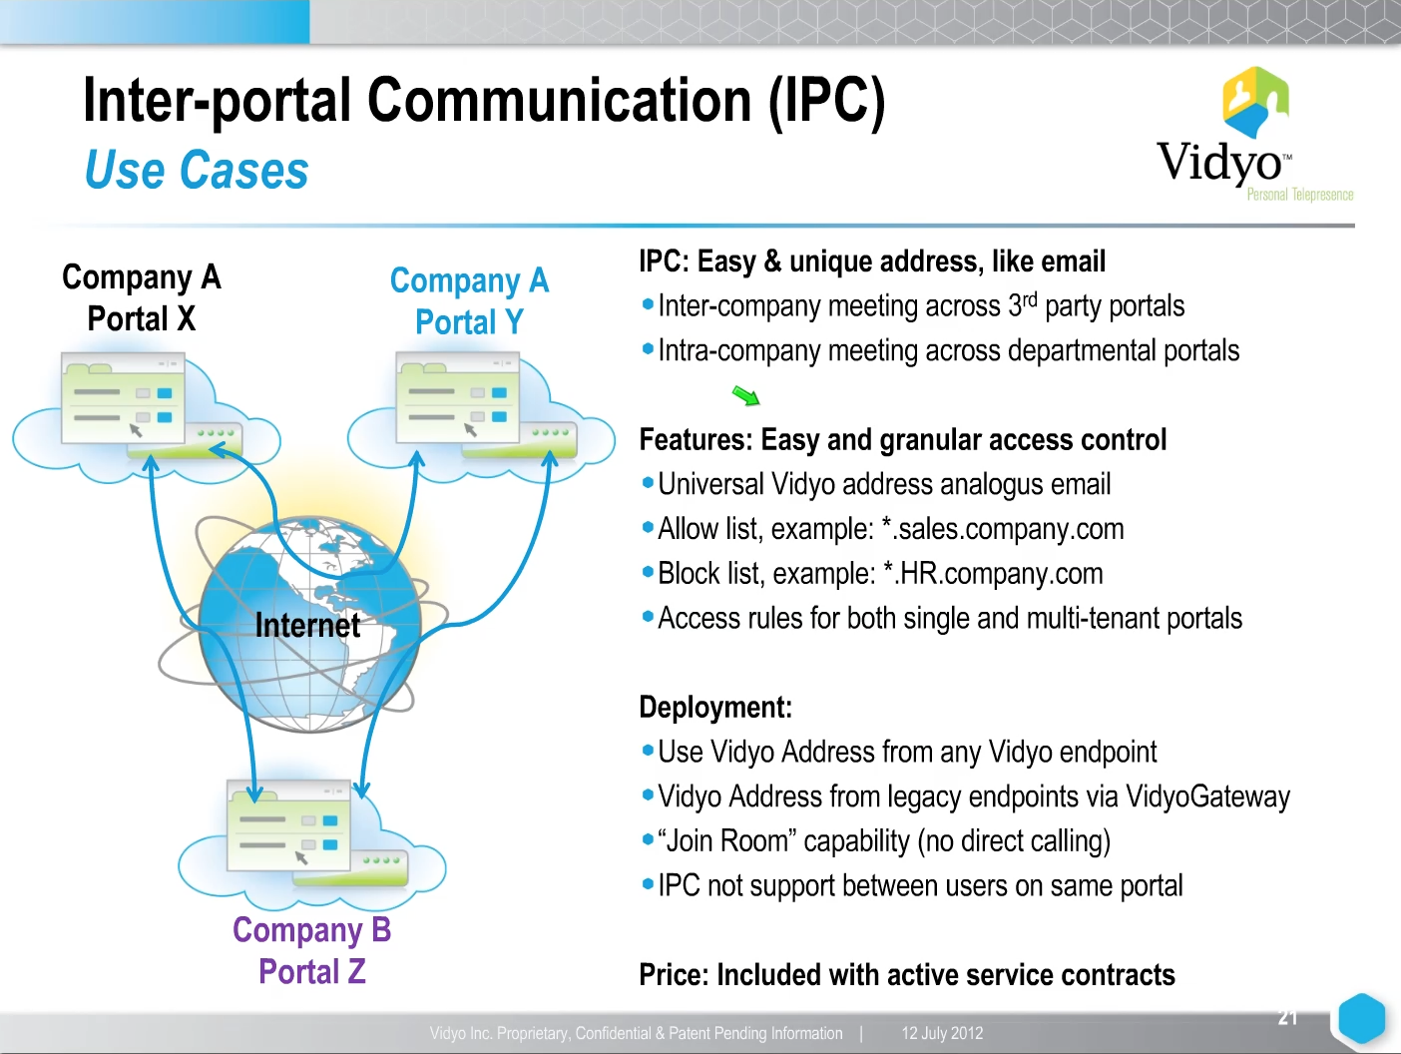
Inter Portal Communication (IPC) – General Overview

Slide 60
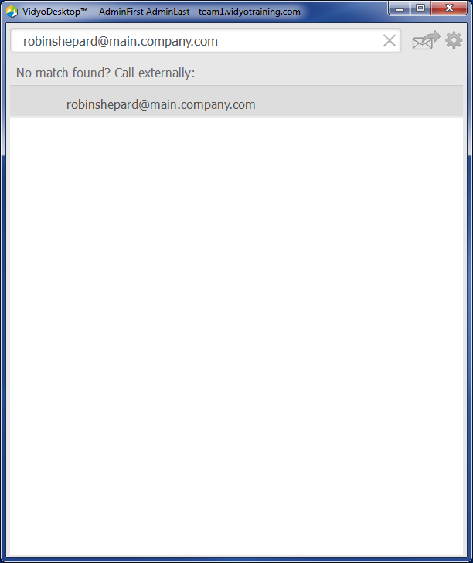
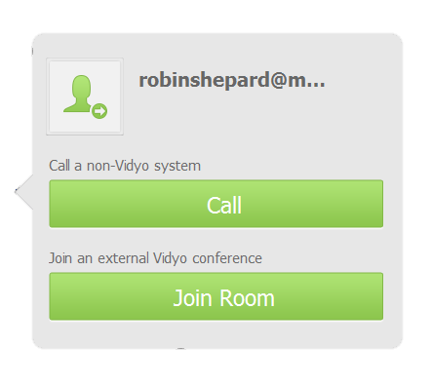
Inter Portal Communication (IPC) - Example
Your Portal Address
username@portal
Click ‘Join Room’ to join 3rd party portal

Slide 61
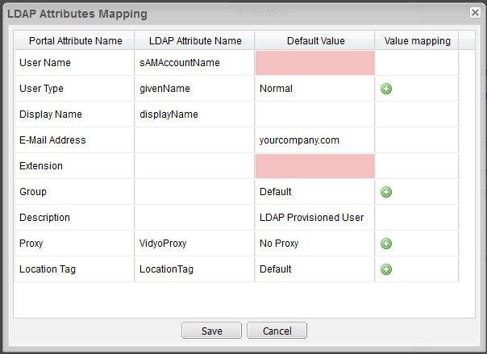
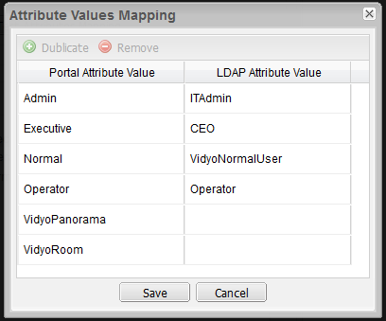
LDAP/AD Auto Provisioning - Configuration
VidyoPortal accounts are automatically created upon successful authentication
Map VidyoPortal attributes to LDAP attributes
Map values (either same or different) between VidyoPortal and LDAP server

Slide 62
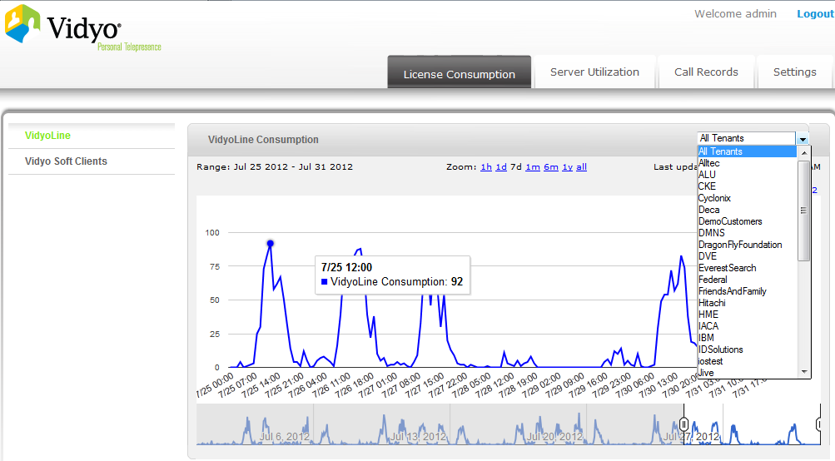
VidyoDashboard – General Overview
Provides system administrators with the following VidyoConferencing system analytics:
License Consumption (installs)
Server Utilization
Call Records
Configuration Settings
This standalone software is currently
available as a VMware image (OVA) file.

Slide 63
SNMP – Basic Server Monitoring
Provides basic SNMPv2 MIBs
SNMP Docs (OI list and MIBs) available via http://support.vidyo.com

Slide 64
UC Clients - Plugins
UC (Universal Communication) Client is a licensable feature that allows you to integrate the following plugins with Vidyo:
Microsoft OCS/Lync
Adobe Connect
IBM Sametime

Slide 65
Vidyo Server Maintenance/Upgrades

Slide 66
Vidyo Server - Firmware Updates
Free for customers with a current support contract
Firmware is available at http://support.vidyo.com
http://selfservice.vidyo.com contains Upgrade paths for all servers
Server | Upgrade Interface Name | URL
VidyoOne/VidyoPortals | Super Admin Interface | http(s)://[VidyoOne/VidyoPortal IP or FQDN]/super
VidyoRouters | VidyoRouter Configuration Page | http(s)://[VidyoRouter IP or FQDN/vr2conf]
VidyoGateways | VidyoGateway Configuration Page | http(s)://[VidyoGateway IP or FQDN]
VidyoReplays | VidyoReplay Configuration Page | http(s)://[VidyoReplay IP or FQDN]

Slide 67
VidyoDesktop/VidyoRoom - Auto Updates
VidyoDesktop and VidyoRoom client software are ‘pushed’ by the VidyoPortal
Endpoint software can be uploaded via the Super Admin (/super) and Admin (/admin) interfaces (remember, an Admin can override the types/version that a Super Admin has uploaded/activated)
Ensure that the correct VidyoDesktop/VidyoRoom client/version is activated
Vidyo’s endpoint software is available for the following:
Windows (user and admin installer available)
Mac
Linux (several distributions are available)
VidyoRoom

Slide 68
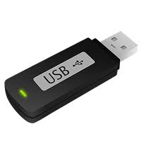
VidyoRoom - Firmware Updates
VidyoRoom Firmware Update/Restore Options
Browser: Upload via VidyoRoom Web UI (IP address of VidyoRoom system)
USB Stick: Access system recovery console with a keyboard by left and right shift keys during boot up
Firmware is available at http://support.vidyo.com

Slide 69
Troubleshooting - VidyoConferencing Solutions

Slide 70
Troubleshooting - Objectives
Troubleshoot Common Vidyo Issues
Properly escalate issues to Vidyo Support
Access additional troubleshooting resources when needed

Slide 71
Troubleshooting – VidyoDesktop Connectivity/Pre-call Issues

Slide 72
Troubleshooting - VidyoDesktop Connection/Pre-call
Unable to Browse to Portal or Login – Port 80/443 Firewall issues
Problem Downloading, Installing or Running VidyoDesktop – IT Issues
Problems Starting VidyoConference – Router Issue, Cloud Rules

Slide 73
Troubleshooting - Connectivity Issues
Firewall and Security Applications
Required Vidyo ports are not open
Vidyo applications are not set as trusted applications
Vidyo servers behind a NAT are not properly configured

Slide 74
Troubleshooting - Connectivity Issues
Web Proxy
VidyoDesktop web proxy settings are not configured properly (e.g. missing required username and password)
Web Proxies that rely on PAC scripts are not properly set

Slide 75
Troubleshooting - Connectivity Issues
HTTPS/SSL
Vidyo infrastructure and/or endpoint components are missing the required certificates
Certificates are expired, revoked or not issued by a valid CA
VidyoPortal’s LDAP settings are not properly configured
Network connectivity issue between the VidyoPortal and the LDAP server

Slide 76
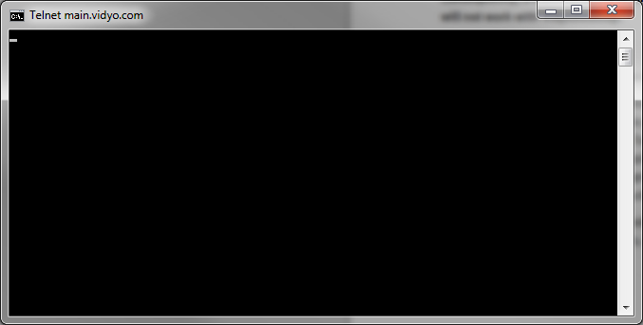
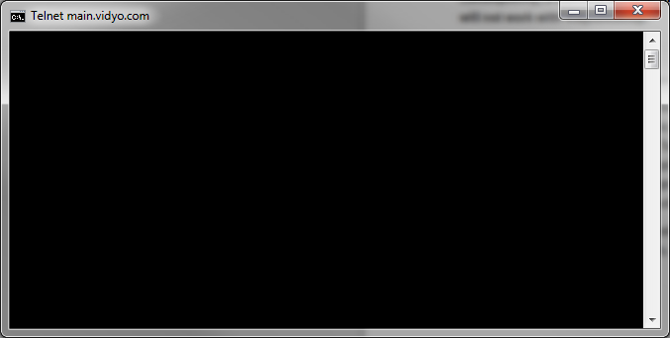
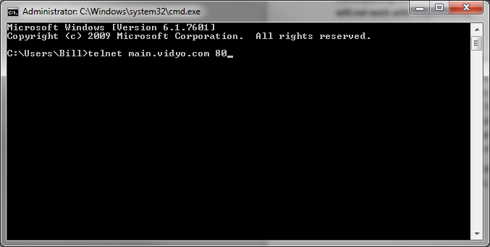
Troubleshooting - Unable to Browse to Portal or Login
Firewall issues can cause the following issues:
Sign-in issues – unable to connect to the VidyoManager
User cannot join a conference call – unable to connect to the VidyoRouter
Disconnect during a conference call – due to UDP traffic termination/timeout
Use ‘Telnet’ to determine if ports are open.

Slide 77
Common VidyoDesktop Performance Issues

Slide 78
Troubleshooting - VidyoDesktop Performance
No Audio – Cannot Hear Others
No Audio – Remote Participants Cannot Hear Me
Hearing Echo on the Call
No Video – Cannot See My Camera
No Video – DirectX Error or Black Window (with others joined)
Video Quality is Poor/Choppy/Freezing

Slide 79
Troubleshooting - VidyoDesktop Performance
Network
Insufficient bandwidth, quality (e.g. Packet Loss, Latency)
Firewall, VPN, Web Proxy

Slide 80
Troubleshooting - VidyoDesktop Performance
VidyoDesktop Settings
Using integrated mic/speaker (without enabling VidyoDesktop’s software echo cancellation)
Enabling VidyoDesktop’s software echo cancellation when using devices with built-in hardware echo cancellation
The use of proxy

Slide 81
Troubleshooting - VidyoDesktop Performance
Hardware
Optimal Power Plan not set
1080p@30fps / 720p@30fps Option Enabled
CPU Load (additional CPU intensive applications are running during a conference call)
CPU Specifications (minimum requirements not met)
Not enough memory resources - 1GB RAM and 128MB Video RAM (VRAM)

Slide 82
Troubleshooting - VidyoDesktop Performance
Software
Outdated Drivers (audio card, video card, camera)
DirectX 9.0c (minimum)
Missing Flash plug-in

Slide 83
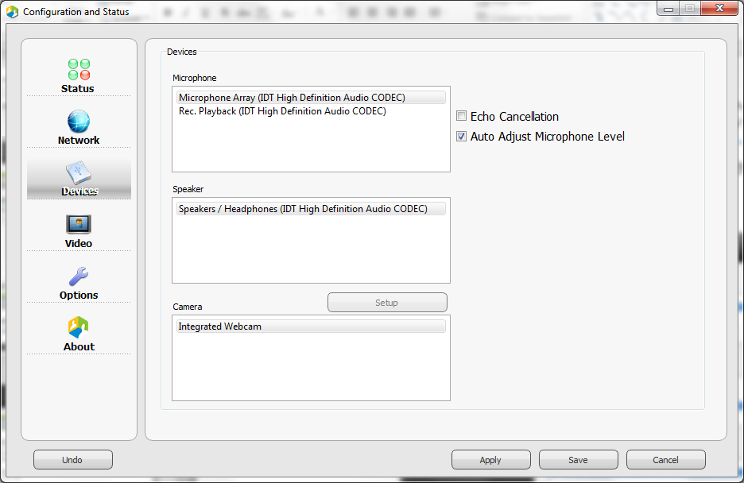
Troubleshooting - Echo On the Call
Using a laptop’s integrated mic/speaker without enabling VidyoDesktop’s software echo cancellation may cause echo

Slide 84
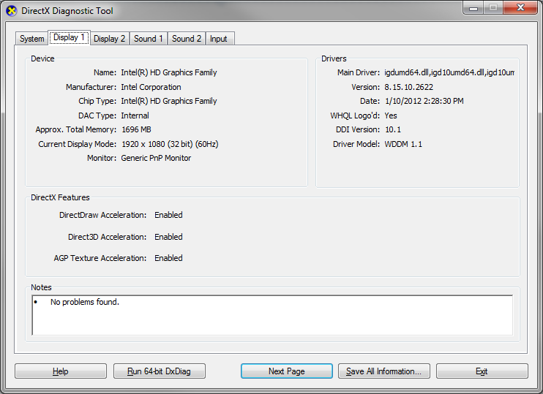
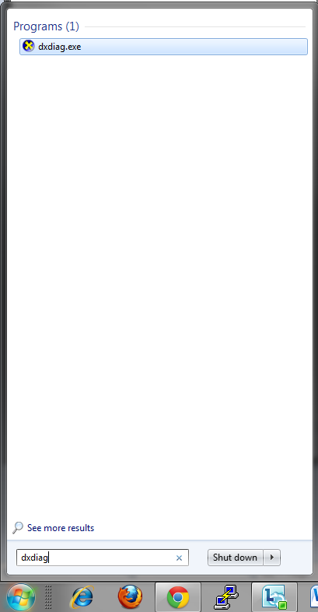
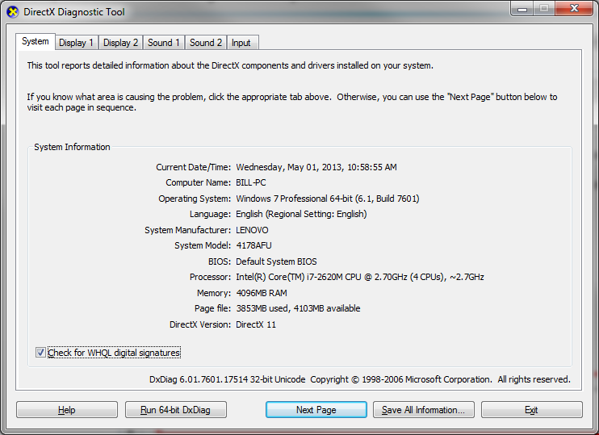
Troubleshooting - DirectX Error or Black Window
Run ‘dxdiag’ from the run or search programs and files prompt

Slide 85
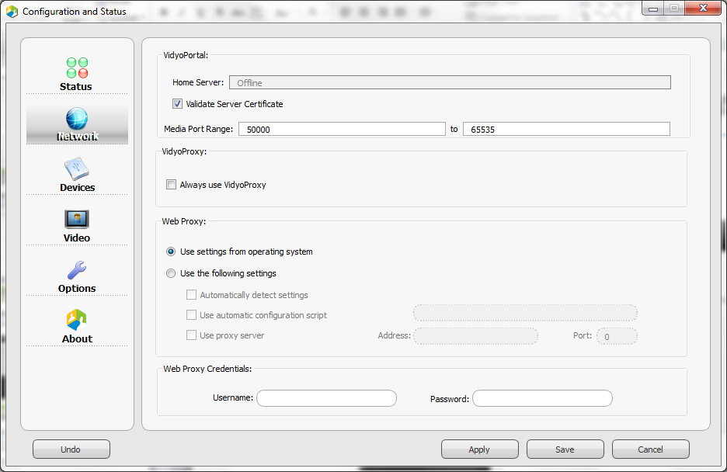
Troubleshooting – Poor Quality Audio/Video
Is the user connected via VidyoProxy?

Slide 86
Troubleshooting – Audio/Video Quality Issues
VidyoDesktop Alarms
VidyoDesktop alarms will be generated when a performance issue is detected
When at least one alarm raised, the configuration button on main VidyoDesktop window will turn red
VidyoDesktop alarm details appear at the bottom of the Status tab, within the Configuration and Status dialog
Alarm Examples:
High CPU utilization limits quality of conference
Insufficient network send bandwidth limits quality of own video
Insufficient network send bandwidth limits resolution of own video
Insufficient network receive bandwidth limits number of viewable participants

Slide 87
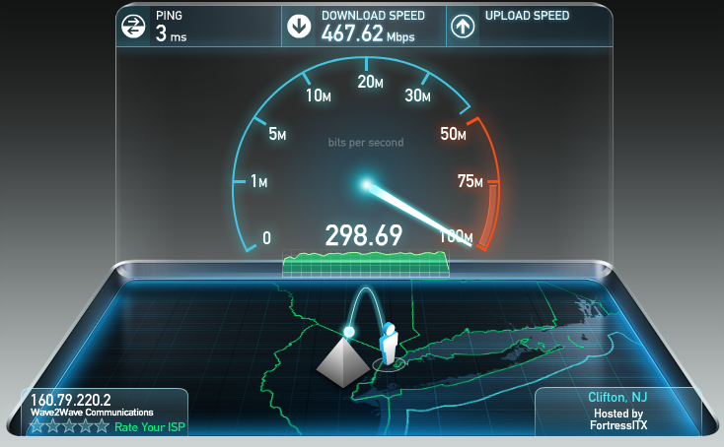
Troubleshooting – Audio/Video Quality Issues
Network Bandwidth
Insufficient bandwidth will impact performance generate VidyoDesktop alarms
Conduct a speed test (e.g. www.speedtest.net)
2Mbps down/1Mbps up should be sufficient for a ‘good’ experience

Slide 88


Troubleshooting – Audio/Video Quality Issues
CPU Power Plan
To ensure optimal performance, use High/Maximum Performance Power Plan when plugged in
Avoid ‘Battery Saver’ power plans when plugged in as they can throttle your CPU resources

Slide 89


Troubleshooting – Audio/Video Quality Issues
Check CPU utilization in task manager
An alarm may be generated if the CPU utilization is above 90%

Slide 90

Troubleshooting – Audio/Video Quality Issues
Video Preferences
Use the recommended ‘Best Quality’ option to avoid performance issues
Users may force 720p30 without fully understanding the impact that it will have on their CPU
Users may force Limited Bandwidth, which will limit their transmit resolution

Slide 91



Troubleshooting – Audio/Video Quality Issues
Network – Quality (e.g. Packet loss, latency)
Check Conference Status for NACKs
NACKs are an indication of UDP packet loss
These NACKs typically represent a problem between the receiver and the VidyoRouter representing that user’s video
These NACKs typically represent a problem between you and the VidyoRouter
‹#›

Slide 92

Troubleshooting – Audio/Video Quality Issues
Ping VidyoRouter while not in a conference call (ping –l 1300 IP/URL –t)
Latency should be under 200ms
Jitter or latency delta between each consecutive ping should be under 15ms
No time outs
Microsoft Windows XP [Version 5.1.2600]
(C) Copyright 1985-2001 Microsoft Corp.
C:\Documents and Settings\Ami>ping demo.vidyo.com -t
Pinging demo.vidyo.com [64.208.203.165] with 32 bytes of data:
Reply from 64.208.203.165: bytes=32 time=95ms TTL=47
Reply from 64.208.203.165: bytes=32 time=96ms TTL=47
Reply from 64.208.203.165: bytes=32 time=97ms TTL=47
Reply from 64.208.203.165: bytes=32 time=95ms TTL=47
Reply from 64.208.203.165: bytes=32 time=96ms TTL=47
Reply from 64.208.203.165: bytes=32 time=97ms TTL=47
Reply from 64.208.203.165: bytes=32 time=95ms TTL=47
Reply from 64.208.203.165: bytes=32 time=95ms TTL=47
Reply from 64.208.203.165: bytes=32 time=95ms TTL=47
Reply from 64.208.203.165: bytes=32 time=95ms TTL=47
Reply from 64.208.203.165: bytes=32 time=95ms TTL=47

Slide 93

Troubleshooting – Audio/Video Quality Issues
What does this tell us?
The link “seems” ok when there’s no video traffic
Link works ok over long lengths of time
Link breaks down when constant low latency traffic starts (i.e. video / audio)
What kind of connection?
Wired or wireless?
Cable, DSL, T1?
Check for other programs using the network (Outlook, Downloading movies, etc…)
Check for other users on the network using bandwidth
Ping server while in call
High latency > 200ms
Multiple time outs
Wide range of latencies

Slide 94
Troubleshooting – Audio/Video Quality Issues
Outdated Camera, Video and Audio Drivers May Impact Performance
Driver version/date can be obtained from the Dxdiag log that is included with the VidyoDesktop log zip file
Drivers older than a couple of years old should be updated if the user is experiencing hardware performance issues

Slide 95
Troubleshooting – Audio/Video Quality Issues
VPNs can cause the following issues:
Connectivity or performance issues
Can limit bandwidth due to encryption overhead
Latency due to routing
Can limit the MTU size

Slide 96
Troubleshooting – Audio/Video Quality Issues
Is a Web Proxy being used?
By default, VidyoDesktop is set up to ‘Use settings from Internet Explorer’
The VidyoProxy feature must be configured in order for VidyoDesktop to establish a connection though a Web Proxy server
To avoid performance issues due to Web Proxies inspecting media packets, it is highly recommended to create exceptions (e.g. Bluecoat) or allow DIRECT connections to the Vidyo infrastructure (bypassing the Web Proxy). In many occasions, this can be accomplished by simply editing the PAC script.

Slide 97
Troubleshooting – Common VidyoRoom Issues

Slide 98

Troubleshooting – Common VidyoRoom Issues
Unable to Power Up VidyoRoom
Unable to Connect to VidyoPortal
USB Audio Device is Not Working (No Audio)
No Video
Camera Not Responding to VidyoRemote
Share Device Not Working

Slide 99
Troubleshooting – Unable to Log In
Try to log in with a laptop to the network cable that the VidyoRoom is using
Make sure that you are using a ‘VidyoRoom’ account type
If the VidyoPortal is using HTTPS, the VidyoRoom may be missing the required certificates (error shown in logs)

Slide 100

Troubleshooting – No Video From Camera
Ensure that the camera is connected to the video capture card interface
If using a Sony EVI-HD series camera, please make sure that SYSTEM SELECT is either set to VISCA or set to the correct resolution and frame rate matching what the VidyoRoom system is set to encode
NOTE: If you prefer to set a resolution and frame rate on the camera, you will find a table at the bottom of the Sony EVI-HD series that defines each numbered option
Make sure that the VidyoRoom system’s camera mode is set to a resolution/framerate that is supported by the camera (e.g. 1080p15 is not supported by the Sony EVI-HD series cameras)

Slide 101
Troubleshooting – PTZ is not working
Ensure that USB to VISCA cable is connected to the correct ports – the USB port is labeled on the VidyoRoom and when using the Sony EVI-HD series cameras, you must use the ‘VISCA In’ port
Ensure that the USB end of the VISCA to USB cable connected to the labeled ‘CAM CTRL’ USB port on the rear of the VidyoRoom system
Also, FECC option must be enabled to allow others in the conference call to control the VidyoRoom’s camera

Slide 102
Troubleshooting – Echo
If using line-in/out for audio, please make sure that the customer is using a separate echo cancellation device (speakerphones with hardware echo cancellation is an alternative)
If using line-out from the Interact AT solution, the Interact software must be configured to enable echo cancellation when outputting to an external amplified or powered speaker

Slide 103
Troubleshooting – Poor Video Quality
Outbound
Check transmit bandwidth setting on VidyoRoom system to ensure that it is not set too low
Run a speed test on the network that the VidyoRoom is using to determine if the VidyoRoom system has sufficient bandwidth
Inbound
Run a speed test to determine if the VidyoRoom system has sufficient bandwidth

Slide 104
Troubleshooting – Common VidyoGateway Issues

Slide 105
Troubleshooting – Common VidyoGateway Issues
Unable to Connect to H.323 Endpoint
Unable to Connect to Legacy SIP Endpoint
SIP endpoint cannot connect to a Vidyo hosted conference (room)

Slide 106
Troubleshooting – Legacy SIP Endpoint Connection
Cannot make outbound calls to SIP endpoint
Confirm outbound dialing string (Vidyo do not support URI dialing that requires SRV lookup)
Check gateway SIP Configuration settings in gateway.
Is there a SIP server address configured.
If so, is SIP endpoint registered with configure SIP server
Verify SIP INVITE is being sent to destination endpoint.
Start capture
Make test call
Stop Capture
Download log
Send logs to Vidyo Support

Slide 107
Troubleshooting – SIP Connection to Meeting Room
Cannot connect inbound SIP endpoint to Vidyo.
Confirm proper gateway outbound dialing string.
Verify if the SIP endpoint is able to connect to other SIP endpoints that are on or similar networks as the VidyoGateway.
Make sure you are trying to connect over UDP not TCP (gw only supports UDP)
Verify that call reaches gateway.
Start Capture
Make test call
Stop Capture
Download log
Send logs to Vidyo Support
Is the SIP endpoint registered to a SIP server or registrar and is it allowed to make outbound calls.

Slide 108
Troubleshooting – Collecting Log Files and Diagnostics

Slide 109
Troubleshooting – Collecting General Information
Exactly when did the user encounter the problem?
Has the user ever been operational?
What are the symptoms that the user is experiencing?
Is the user experiencing any error messages or alarms and if so, what is the exact syntax of the error message(s)?
Are any other users experiencing the problem?

Slide 110
Troubleshooting – Collecting General Information
Has anything changed (e.g. location, endpoint hardware, accessories, network, firewall, software update)?
Can the user recreate the problem?
What version(s) are running on the involved infrastructure components and endpoint(s) (VidyoDesktop, VidyoPortal, VidyoRouter, etc.) ?
Consider gathering information via TeamViewer

Slide 111
Troubleshooting – Collecting Log Files
Reported Issue | Required Logs | Notes
Error installing VidyoDesktop | VidyoDesktop / VidyoRoom Logs | Include computer type, OS version, and screenshots of any error messages.
Connecting to VidyoPortal Issues | VidyoDesktop / VidyoRoom Logs | Include computer type, OS version, and screenshots of any errors, as well as type of antivirus/security application.
Problem starting Vidyo call | VidyoDesktop / VidyoRoom Logs | Screenshots of any errors, as well as type of antivirus/security application.
Audio issues | VidyoDesktop / VidyoRoom Logs | Include types of audio devices.
Quality issues | VidyoDesktop / VidyoRoom Logs | Include group setting, if known, as well as available bandwidth.

Slide 112
Troubleshooting – Collecting Log Files
Video issues | VidyoDesktop / VidyoRoom Logs | Notes
Content sharing issues | VidyoDesktop / VidyoRoom Logs
DirectX error | VidyoDesktop / VidyoRoom Logs
VidyoDesktop disconnect issues | VidyoDesktop / VidyoRoom Logs | You should collect VidyoManager logs, screenshots of any errors, as well as the name and version of any security application.
Issues with calls to/from H.323/SIP system | VidyoGateway and VidyoDesktop / VidyoRoom Logs
VidyoPortal shows component down | Component log VidyoManager, VidyoRouter, etc.

Slide 113

Troubleshooting – Collecting VidyoDesktop Log Files
Click the ‘Generate Diagnostics Report’ button
The logs will be zipped and saved to the user’s Desktop
Please specify the date/time that the issue occurred when you escalate the issue

Slide 114
Troubleshooting – Collecting VidyoMobile Log Files
Android devices can send their logs directly from the VidyoMobile application
IOS devices output their logs to iTunes
VidyoMobile log capturing instructions are provided in the Getting Help section of the VidyoMobile User Guide
Please reference the VidyoMobile User Guides (click here)

Slide 115
Troubleshooting – Collecting Linux Log Files
Linux log capturing instructions are provided in the VidyoDesktop User Guide (page 72)

Slide 116

Troubleshooting – Collecting VidyoRoom Log Files
Vidyo Support will let you know if changing log levels are necessary

Slide 117

Troubleshooting – Collecting VidyoGateway Log Files
The goal with obtaining VidyoGateway log files is to start the capture, recreate the issue and immediately stop the capture once the issue has been recreated.
Please make sure that you capture the *.pcap file as part of the capture before sending the zipped log file to Vidyo Support

Slide 118
Troubleshooting – Collecting Infrastructure Log Files
In most cases, VidyoDesktop logs are sufficient for Vidyo to determine the cause of connectivity and/or performance issues (when basic troubleshooting has been exhausted)
For issues that impact a conference call (all participants), please include the VidyoManager and VidyoRouter(s) log file(s)
Please reference the Vidyo Troubleshooting Assistance document (click here)

Slide 119
Troubleshooting – VidyoDesktop Best Practices
To help ensure the best Vidyo experience, please follow these guidelines:
Be aware when using wireless connections, wired will always be best
Make sure that when wired, wireless is disabled
Check Camera FPS settings
Avoid analog recording and playback devices
Use a USB Headset or echo cancelling speakerphone (digital) vs. analog sound card
DO NOT use a USB hub for camera and headset
Check PC power settings, avoid power save if not plugged in
Beware VPN software (may block ports or redirect traffic thru VPN)
Beware personal Firewall/Malware clients

Slide 120
Vidyo Support - Escalation Best Practices

Slide 121
Vidyo Support - Support Levels
Support Level | Responsibility
Tier 1 | End-User
Tier 2 | Designated Trained Personnel - Partner
Tier 2, 3 & 4 | Vidyo
Escalations to Vidyo Support must come from designated trained personnel
The service is provided according to the service plan acquired

Slide 122
Vidyo Support – Contacting Support
By phone:
North and South Americas: + 1 866 99 VIDYO
France, Rest of EMEA, India : + 33 975 18 19 00
Italy: +39 0699266512
United Kingdom: +44 2035141783
Online at https://selfservice.vidyo.com/
By email:
emeasupport@vidyo.com
support@vidyo.com
apjsupport@vidyo.com

Slide 123
Vidyo Support - Contacting Support Best Practices
Creating and managing your cases via Vidyo’s Self-Service Portal (https://selfservice.vidyo.com/) provides the following benefits:
Visibility of all of your organization’s cases
Centralizes communication between your team and the Vidyo Support Team
If you do not have access to Vidyo’s Self-Service Portal (for direct partners and end uses with Plus level support), please email emeasupport@vidyo.com (EMEA only) or iteam@vidyo.com (for all others)

Slide 124
Vidyo Support - Contacting Support Best Practices
Call us for URGENT requests
Severity 1 & Severity 2 requests shall be handled via phone support
Avoid sending emails directly to one of our support engineers as they could be in the field or assisting other customers
RMA/ARMA requests - the best way to expedite the request is to make sure we have the following information:
Serial number
Software version
Return address

Slide 125
Vidyo Support - Escalation Procedures
When escalating an issue, please include the following information:
Details regarding the symptoms that the user is experiencing
Time and date
VidyoDesktop Diagnostics Report (includes hardware used)
Vidyo Infrastructure and VidyoDesktop version and OS version
Screenshots and error message pop-up (please provide the exact error syntax)

Slide 126
Vidyo Support - Response Times
Phone requests
URGENT issues (S1 and S2) such as outages, high impact issues or any issue that requires our immediate attention
Immediately acknowledged by a support representative
CS Engineer is available within 4 hours from the original call
Self-Service Portal and Email requests
Response time for email requests is up to one business day

Slide 127
Vidyo Support - Additional Resources
Additional technical notes, firmware updates and security patches are also available on http://support.vidyo.com
Admin and user guides are available within the admin and user interfaces
Super Admin and Admin Interfaces (click the ?)
VidyoPortal user interface (click help)
Vidyo Certified Deployment and Support (VC-DSE) Training Videos (available on Self-Service Portal)

Slide 128

Day Three Finish Line
Congratulations! You should now be able to:
Add and configure multiple tenants
Set up a VidyoCloud
Deploy the Vidyo solution
Upgrade and maintain Vidyo components
Troubleshoot common video and audio issues

Slide 129

VC-DSE Exam
Access VC-DSE Course at http://training.vidyo.com
Please be mindful of others who may be testing when you complete the exam
Please complete the training survey after you complete the exam.

Slide 131
Troubleshooting Flowcharts

Slide 132
Unable to Browse to VidyoPortal or Log in
Can you browse to a public website (e.g. www.vidyo.com)?
Can you reach the VidyoPortal URL?
Are you seeing the login screen?
Are you receiving an error message?
Please reference the VidyoDesktop Troubleshooting Flowchart (click here)

Slide 133
Issues Downloading, Installing or Running VidyoDesktop
Does the VidyoPortal prompt you to download VidyoDesktop?
Does the installer download?
Do you have administrative privileges to install new software?
Please reference the VidyoDesktop Troubleshooting Flowchart (click here)

Slide 134
Audio Issues
Is the speaker icon in the VidyoDesktop application toolbar red (muted)?
Is it only one participant that you cannot hear or all participants?
Are others able to hear the participant?
Please reference the VidyoDesktop Troubleshooting Flowchart (click here)

Slide 135
Remote Participants Not receiving Audio
Is the microphone icon in the VidyoDesktop application toolbar red (muted)?
Is it only one or all participants who cannot hear me?
If only one, can this participant not hear others or only you?
Are you sending audio bandwidth?
Please reference the VidyoDesktop Troubleshooting Flowchart (click here)

Slide 136
Hearing Echo On the Call
Does anyone on the call not hear the echo?
If only one person does not hear the echo, does that user have a headset or speakerphone with built-in echo cancellation?
If not, have you tried enabling software echo cancellation within the VidyoDesktop device settings?
Please reference the VidyoDesktop Troubleshooting Flowchart (click here)

Slide 137
Video Issues, Cannot See Local Camera
Can you see your local preview in VidyoDesktop?
Is your camera plugged in?
Is there another application using the camera?
Is the proper camera selected?
Please reference the VidyoDesktop Troubleshooting Flowchart (click here)

Slide 138
Video Issues, DirectX Error or Black Window
Is the user receiving an error?
Does the call stay connected and can you hear others?
Is the VRAM 128MB or higher?
Is DirectX 9.0c or higher installed?
Are DirectDraw AND Direct3D acceleration enabled?
Please reference the VidyoDesktop Troubleshooting Flowchart (click here)

Slide 139
Audio/Video Quality is Poor/Choppy/Freezing
Is the issue experienced by all, a group or a single participant?
Do the affected have sufficient bandwidth and CPU resources?
Is VidyoProxy being used?
Is there an alarm being generated?
Please reference the VidyoDesktop Troubleshooting Flowchart (click here)

Slide 140
Common VidyoDesktop Performance Issues
No Audio – Cannot Hear Others
No Audio – Remote Participants Cannot Hear Me
Hearing Echo on the Call
No Video – Cannot See My Camera
No Video – DirectX Error or Black Window (with others joined)
Video Quality is Poor/Choppy/Freezing

Slide 141
Unable to Power Up VidyoRoom
Have you tried disconnecting all of the cables and solely connecting the power and video cables to see if the system powers up?
Do you see a blue light on the power button on the front of the VidyoRoom system?
Please reference the VidyoRoom Troubleshooting Flowchart (click here)

Slide 142
Unable to Connect to VidyoPortal (VidyoRoom)
Are you viewing the account settings page?
Are you receiving an error message?
Is the VidyoPortal using HTTPS/SSL?
Are you able to browse to the VidyoPortal address from another computer using the same network and cable?
Are you using a VidyoRoom account (vs Normal)?
Is the VidyoRoom set up to use the appropriate IP (if static) and network settings?
Please reference the VidyoRoom Troubleshooting Flowchart (click here)

Slide 143
VidyoRoom USB Audio Device is Not Working
Is the VidyoRoom set to use USB audio (does not apply to v2.2.x as they use automatic selection)?
Have you tried connecting the USB audio device to another USB port?
Have you ensured that the system’s mic and speaker are not muted?
Have you tested the USB audio device on another computer?
Please reference the VidyoRoom Troubleshooting Flowchart (click here)

Slide 144
No Video from VidyoRoom camera
Are you able to see video when self-view is activated?
Have you made sure that privacy mode (camera mute) is not active?
If using a Sony EVI-HD series camera, have you made sure that the SYSTEM SELECT is set to the appropriate resolution and frame rate (matching what the VidyoRoom system is set to transmit via its video settings – use the VISCA option if you want the VidyoRoom to set the resolution and frame rate to the camera)?
Is the camera connected to the VidyoRoom’s video capture card port (reference VidyoRoom admin guides for connection diagrams)?
Please reference the VidyoRoom Troubleshooting Flowchart (click here)

Slide 145
Camera Not Responding to VidyoRemote
Is the VidyoRoom’s remote control able to control other functions of the VidyoRoom?
Have you ensure that the VidyoRoom is set to the proper IR receiver setting (e.g. internal vs external IR)?
Is the USB end of the VISCA to USB cable connected to the labeled ‘CAM CTRL’ USB port on the rear of the VidyoRoom system?
If using a Sony EVI-HD series camera, did you make sure that the VISCA end of the VISCA to USB cable is connected to the ‘VISCA In’ port?
Please reference the VidyoRoom Troubleshooting Flowchart (click here)

Slide 146
VidyoRoom Share Device Not Working
Have you ensured that the computer that you are connecting to the USB to VGA/DVI share device is outputting its video signal (secondary display should be enabled)?
Have you made sure that the USB end of the share device is NOT connected to the USB port that is labeled ‘CAM CTRL’?
Please reference the VidyoRoom Troubleshooting Flowchart (click here)

Slide 147
Unable to Connect to Legacy H.323 Endpoint
Does the VidyoPortal display the VidyoGateway‘s virtual endpoints?
Are you using the correct dial string for the device that you are calling?
Does the call connect at all?
Does the call connect but drops immediately?
Please reference the VidyoGateway Troubleshooting Documents (click here)

Slide 148
Unable to Connect to Legacy H.323 Endpoint
Does the call connect but you cannot hear audio nor see video?
Does the call connect but drop consistently after ‘x’ amount of time?
Does the call connect and only audio comes through?
Does the call connect and only video comes through?
Please reference the VidyoGateway Troubleshooting Documents (click here)

Slide 149
Thank you!

